Slide 1
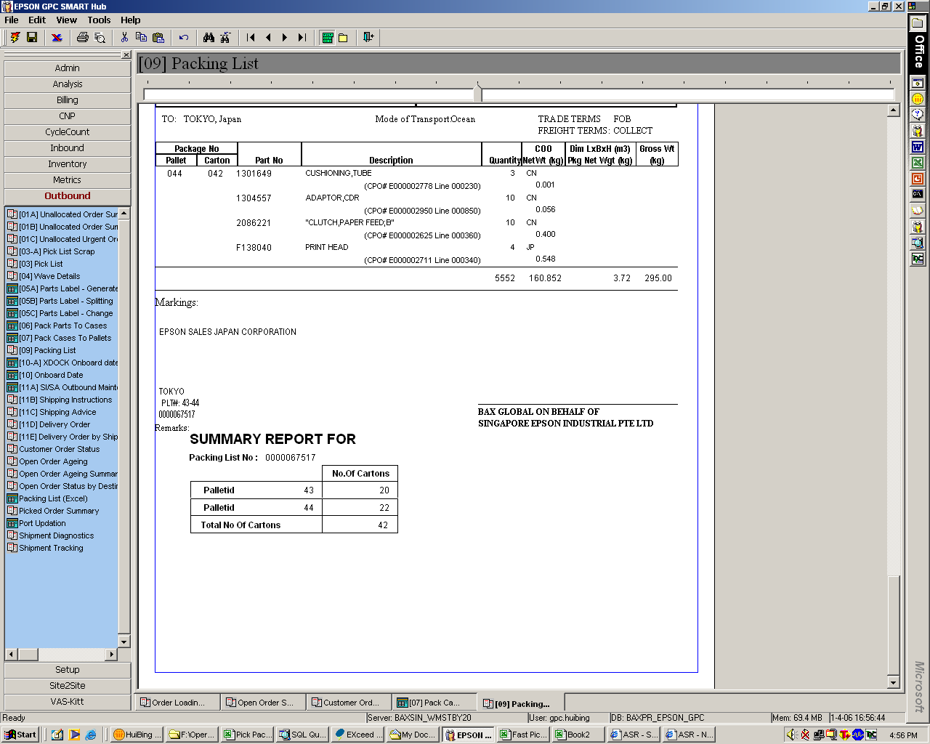
Current: Palletid # starts after the case id.
Proposed: To start Palletid# from 1

Slide 2
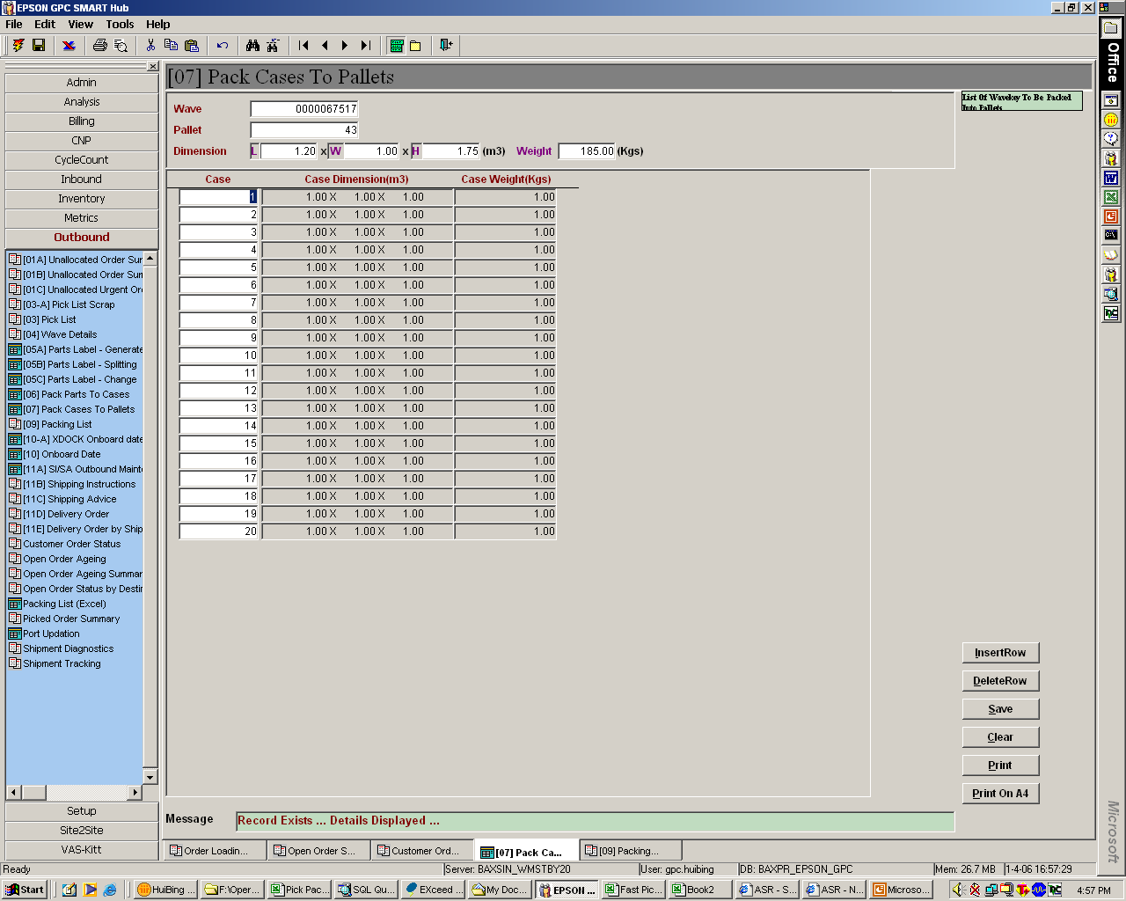
Current: Palletid # starts after the case id.
Proposed: To start Palletid# from 1

